Slide 1

Code Refactoring and Bug Fixing

Slide 2
Scenario:
A team of enthusiastic data scientists embarked on a mission to develop a Note Taking Application using Python, Flask, and HTML. However, their lack of experience in backend development has led to challenges in making the application fully functional. Recognizing your proficiency in backend development, you have been tasked with fixing the broken code and ensuring the application works seamlessly.
Task:
Refactor the existing codebase and ensure the proper functioning of the Note Taking Application. Document all identified bugs during the debugging process. Remember, the task is not about recreating the app from scratch. Your goal is to fix the already existing codebase and make the application work as intended.

Slide 3
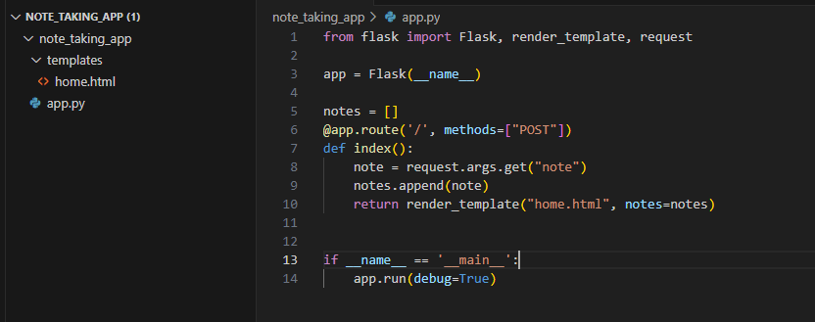
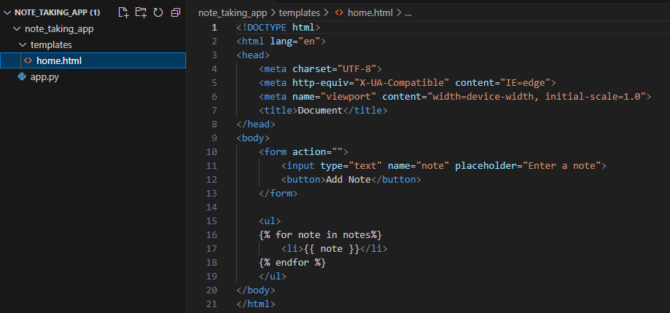
Identifying and Resolving Bugs in the Initial Code
The following code snippet represents the initial state of Flask application, which contains identifiable bugs impacting its functionality.

Slide 4
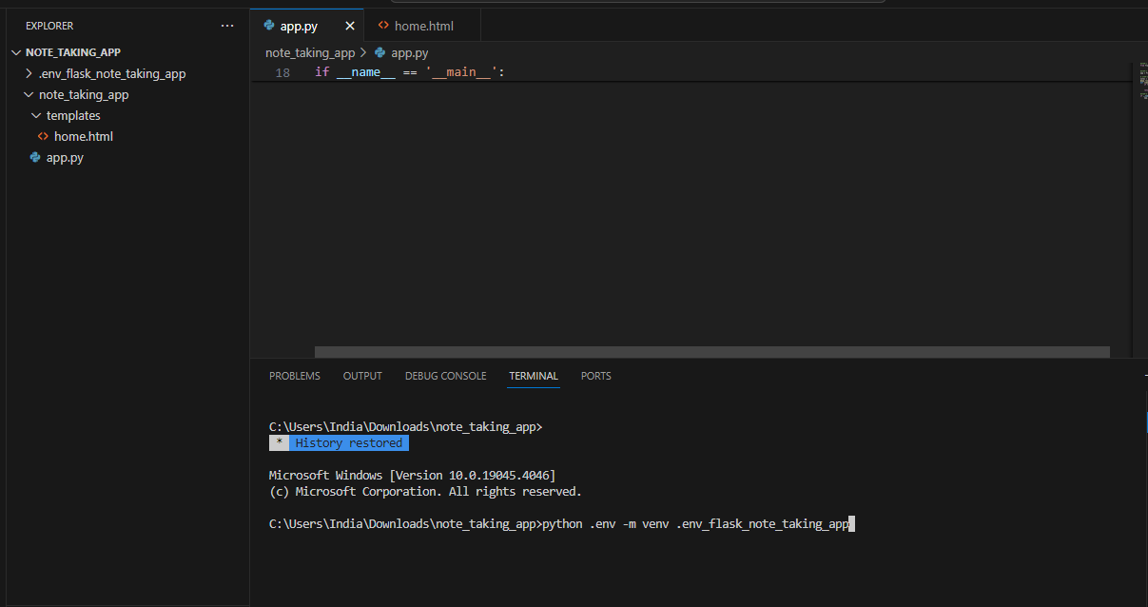
Upon analysis, I identified several bugs that were affecting the performance and reliability of the application.
In the initial state of Flask application, one of the identified issues was the absence of a virtual environment.
Virtual environments are crucial for isolating project dependencies, ensuring consistency across different environments, and avoiding conflicts with system-level packages.
Creating a Virtual Environment:

Slide 5
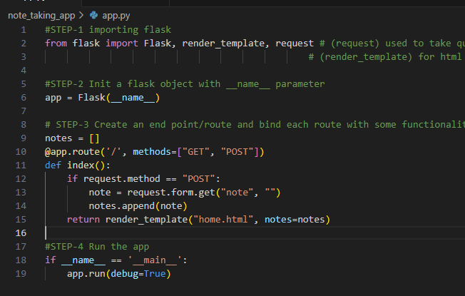
Identifying and Correcting the Second Bug in Python Code:
During the code review process, a second bug was identified in the Python code of Flask application.
Here is a visual representation of the code snippet, illustrating the correction made to resolve the second bug.
The bug was related to handling user input in the form, specifically in the context of POST requests.
To address this issue, modifications were made to handle POST requests appropriately and ensure accurate capture of user notes.
The correction involved adjusting the code to handle POST requests by using ‘request.form.get()’ to capture user notes only when the method is POST, ensuring that the list is approximately updated.

Slide 6
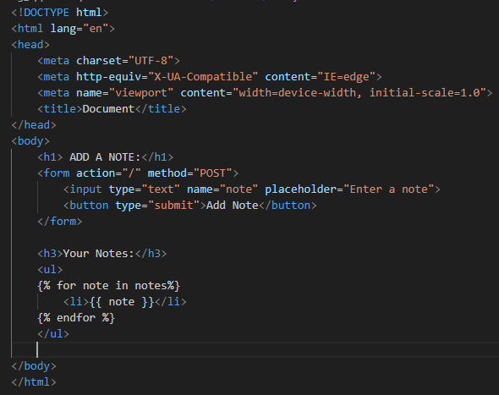
Identifying and Correcting the Third Bug in HTML Code:
Upon inspecting the HTML code, a third bug was identified, affecting the structure and behavior of Flask application interface.
The bug was related to the HTML structure, specifically involving the heading and form action attribute.
To address this issue, modifications were made to the HTML code, including changes to the heading and form action attribute.
The correction involved adjusting the heading structure and the form attribute. The heading tag <h1> was modified, and the form action attribute was updated to reflect the correct route.
Here is a visual representation of the HTML code snippet, illustrating the correction made to enhance the structure and behavior of our Flask application interface.

Slide 7

THANK YOU

